Slide 1
Lending Case Study
Created by:
Bikas Sarkar
Sruthi Melepurath

Slide 2
Agenda
Problem Statement
Lending Club Case Study
Python Code
Plots
Observations and Analysis

Slide 3

Problem Statement

Slide 4
Problem Statement
Company wants to understand the driving factors (or driver variables) behind loan default, i.e. the variables which are strong indicators of default. We need to find the risky loan applicants

Slide 5
Python Code
GitHub Link: https://github.com/Bikash3/LendingClubCaseStudy

Slide 6
Column Considered and Transformations Done
id
loan_amnt
verification_status
home_ownership
int_rate
term
purpose
issue_year
issue_month
emp_length
annual_inc
dti
grade
installment
addr_state
loan_status
delinq_2yrs

Slide 7

Plots

Slide 8
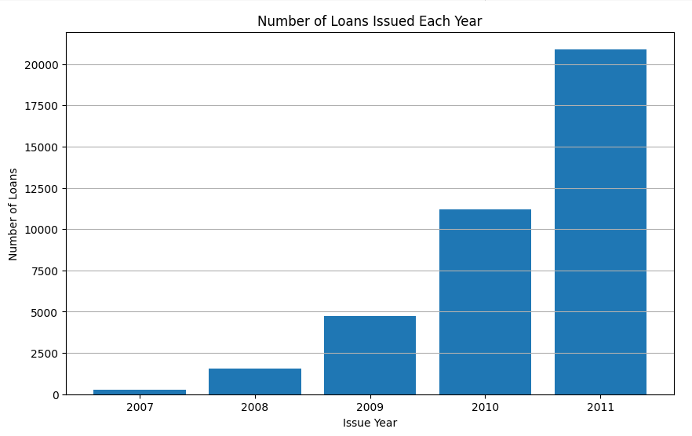
Year wise Loan Count
There was a significant increase in the number of loan applicants between 2007 and 2011.

Slide 9
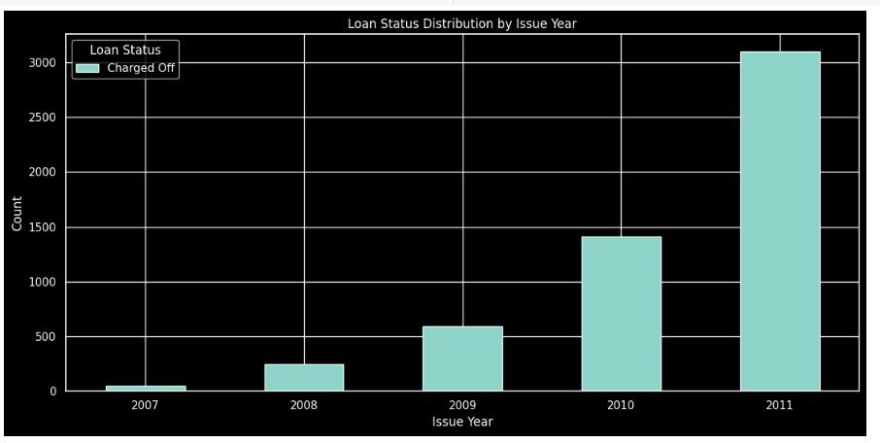
Charged-Off Distribution by Issue Year
Substantial growth between 2007-2011 in the number of charged off loans can be observed.

Slide 10
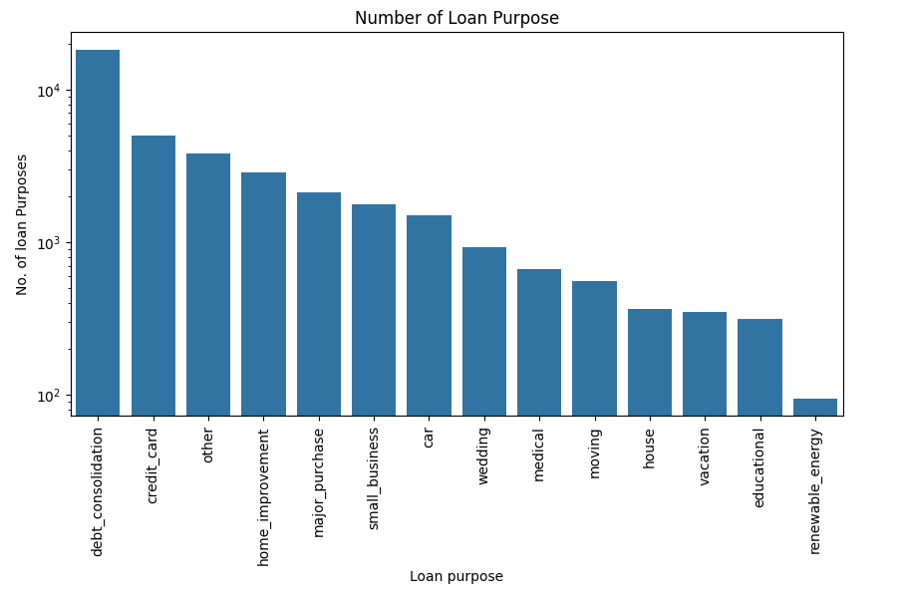
Purpose of Loan vs Interest Rate
The above charts shows five major purposes of Loan applications are - debt_consolidation , credit_card , other , home_improvement & major_purchase
where **debt_consolidation** is the highest loan purpose.

Slide 11
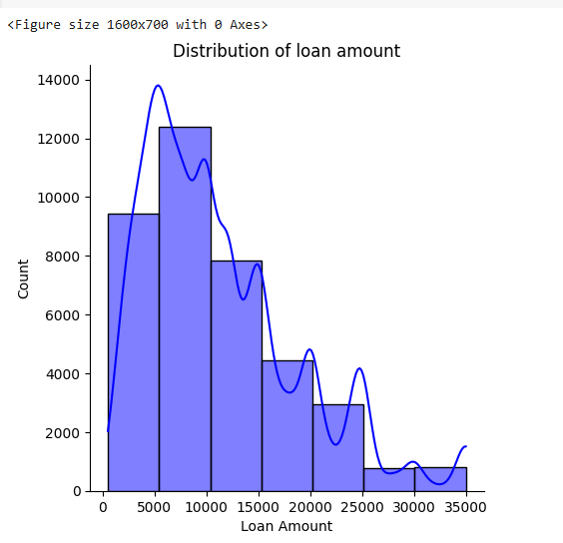
Loan Distribution vs Loan amount
The distribution of loan amount can be visualized from the above plot. It has been observed that the maximum loan range amount is between 5000-10000.

Slide 12
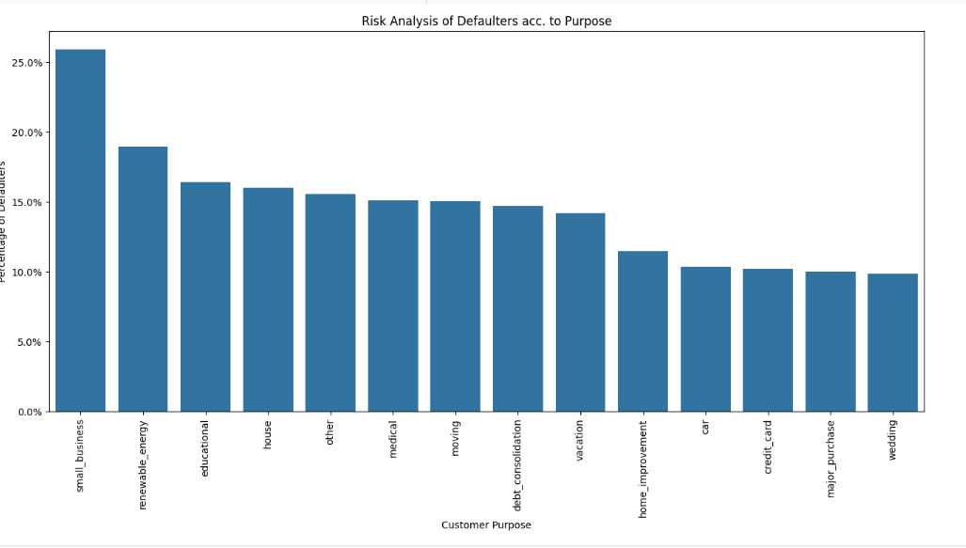
Calculate the percentage of loan defaulters according to loan purpose
Customer Purpose with small_businesses has higher percentage of defaulters.

Slide 13
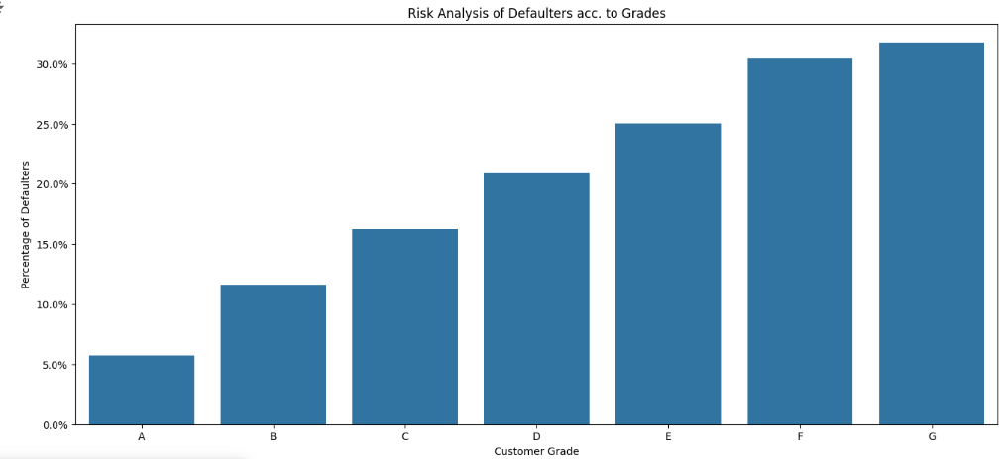
Calculate the percentage of loan defaulters according to grade
The lower customer Grade has higher percentage of defaulters.

Slide 14
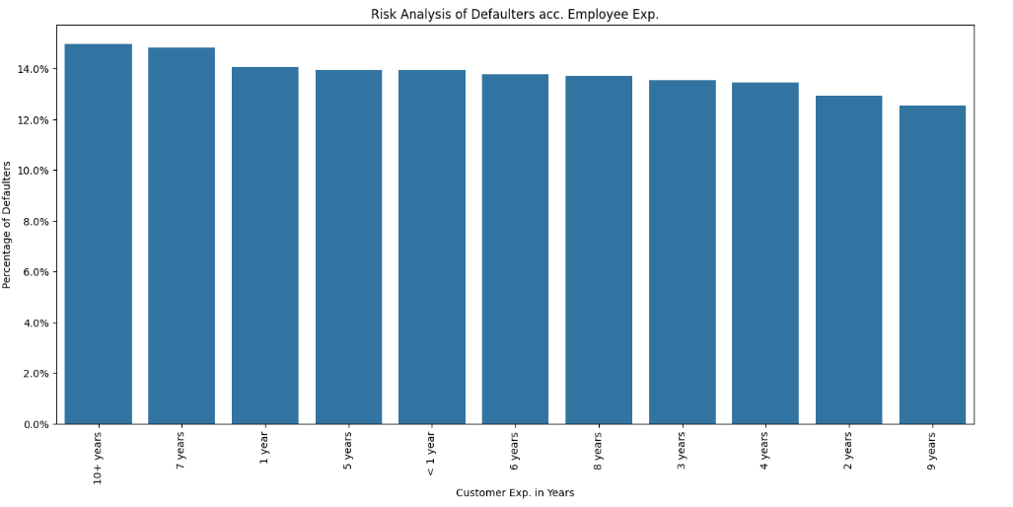
Calculate the percentage of loan defaulters according to Employee experience
Customer with higher Customer exp. has higher percentage of defaulters.

Slide 15
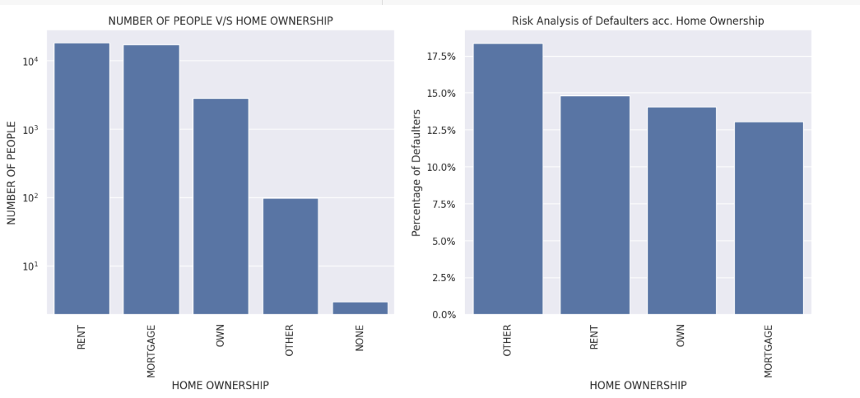
NUMBER OF PEOPLE V/S HOME OWNERSHIP AND Risk Analysis of Defaulters acc. Home Ownership
1. The highest number of people are in **Rent** home ownership.
2. The highest percentage of defaulter is under **Other** home ownership and is followed by Rent and Own and Mortgage.

Slide 16
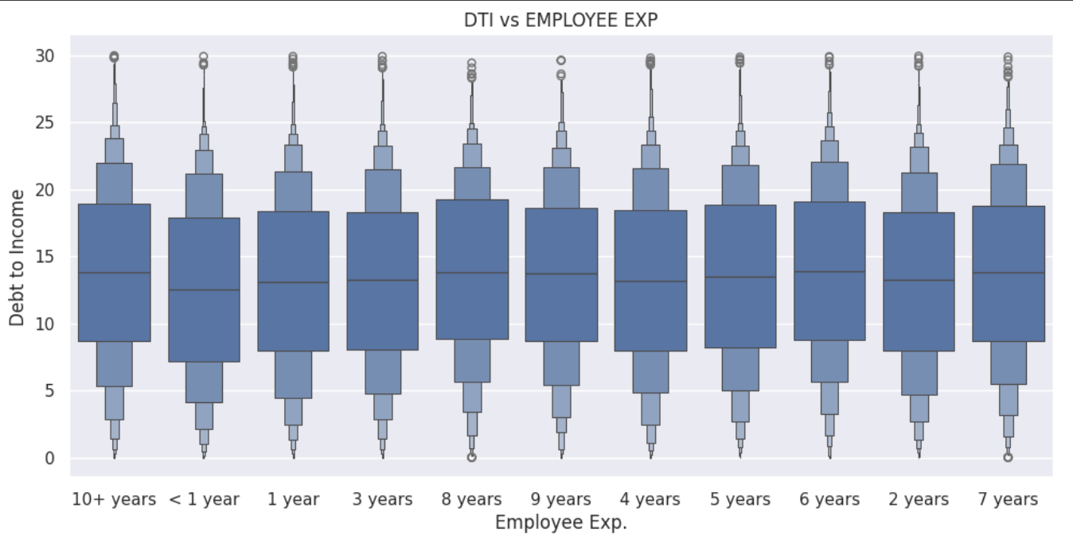
Debt to Income vs Employee Experience
In the bivariate analysis it has been observed that employees with 10+ years of exp. is having a debt to income in the maximum range apart from that rest year of employee exp. are more or less in the same range.

Slide 17
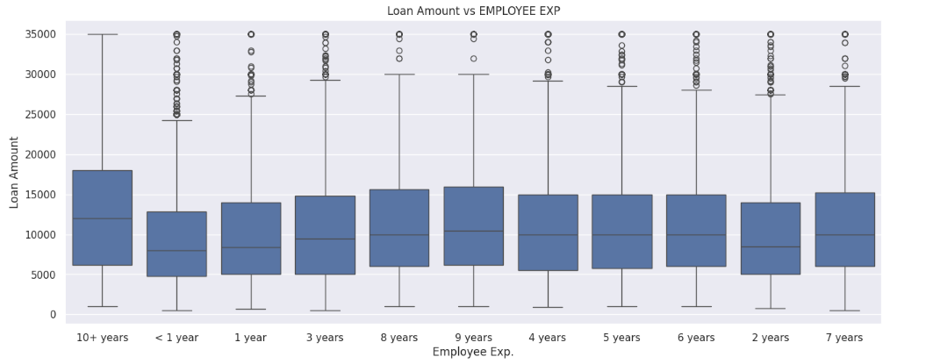
Loan Amount vs Employee Experience
In the above bivariate analysis it has been observed that 10+ years of employee exp. is taking more loans then the other categories.

Slide 18
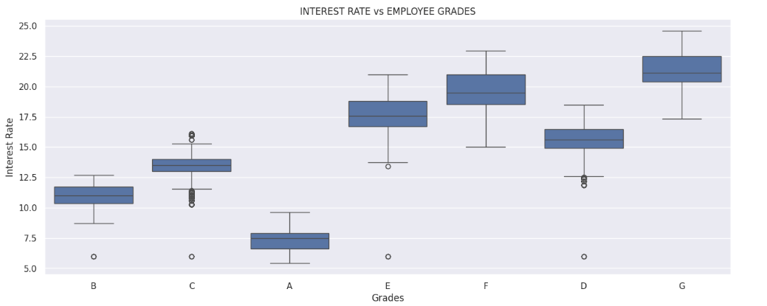
Interest Rate vs Employee Grades
By observing the above plot it has been observed that interest rates are increasing with the decrease in Grades, where A has lowest interest and G has highest.

Slide 19
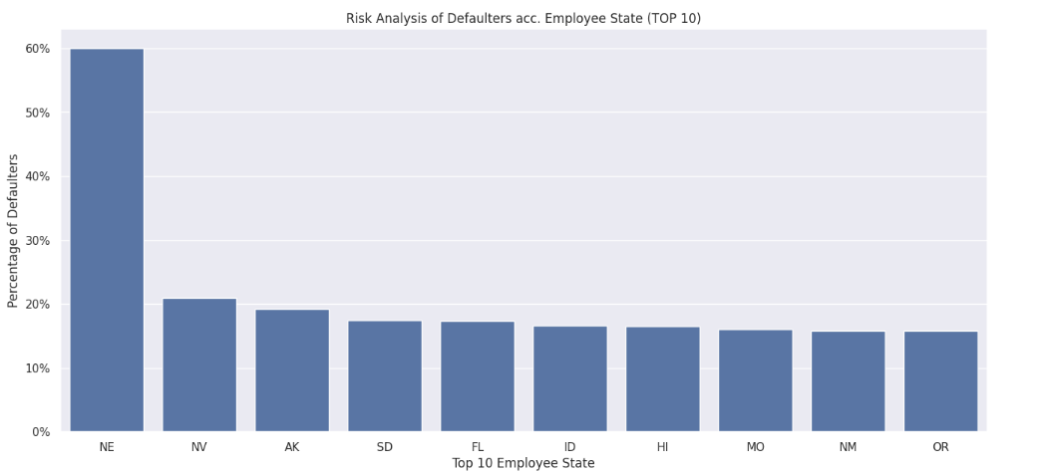
Calculate the percentage of loan defaulters according to address of a state
The above plot shows that NE state has highest percentage of Defaulters.

Slide 20
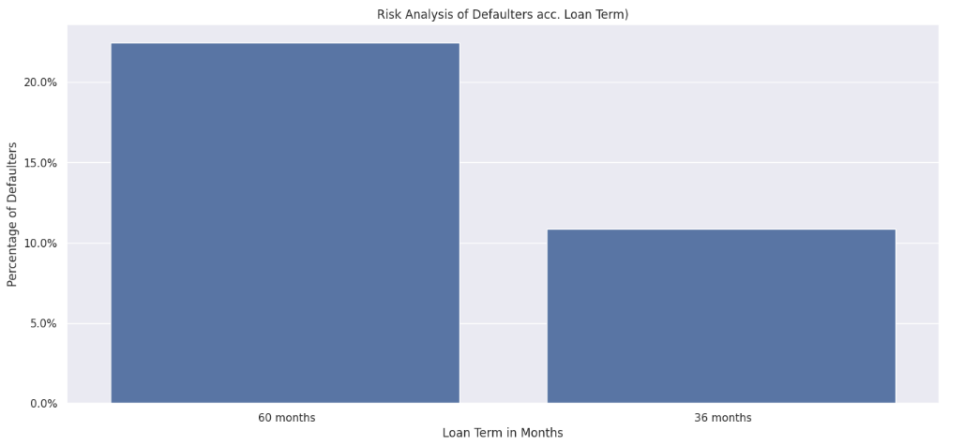
The percentage of Defaulters is much higher in 60 months term then 36 months
The percentage of Defaulters is much higher in 60 months term then 36 months.

Slide 21
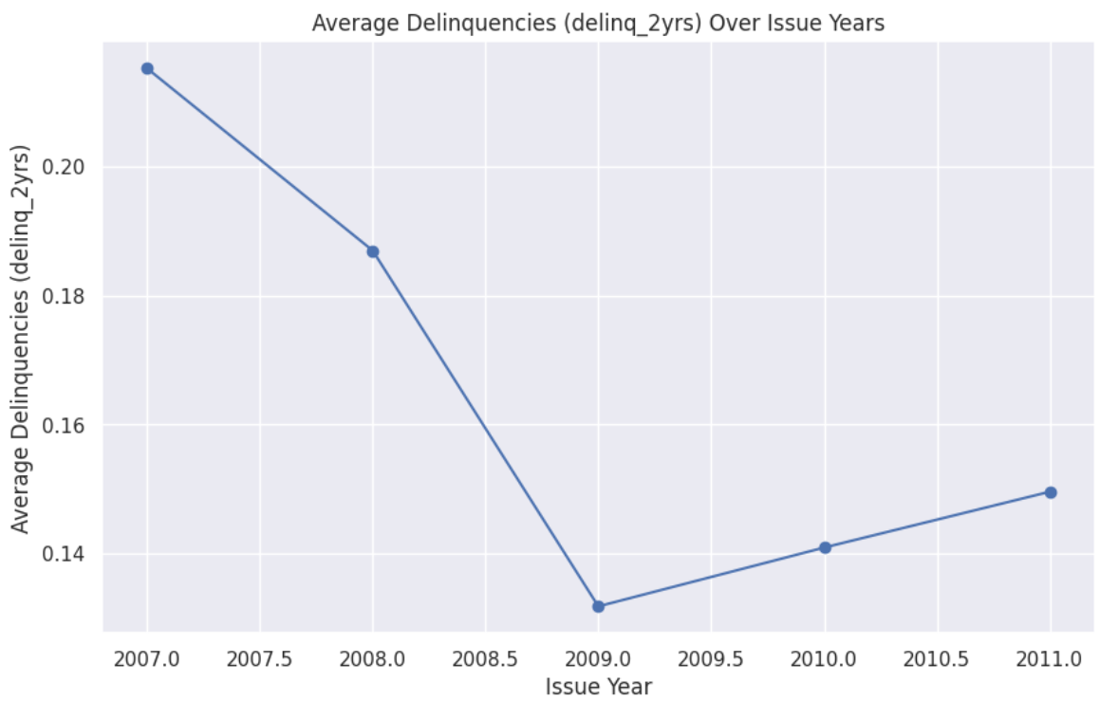
Delinquency Incidences Distribution by Issue Year
Line plot reveals a general increase in delinquency rates over the years, which could indicate that the quality of the loans issued has deteriorated over time, resulting in more defaults. However, it is important to keep in mind that other factors, such as changes in the broader economic environment, variations

Slide 22
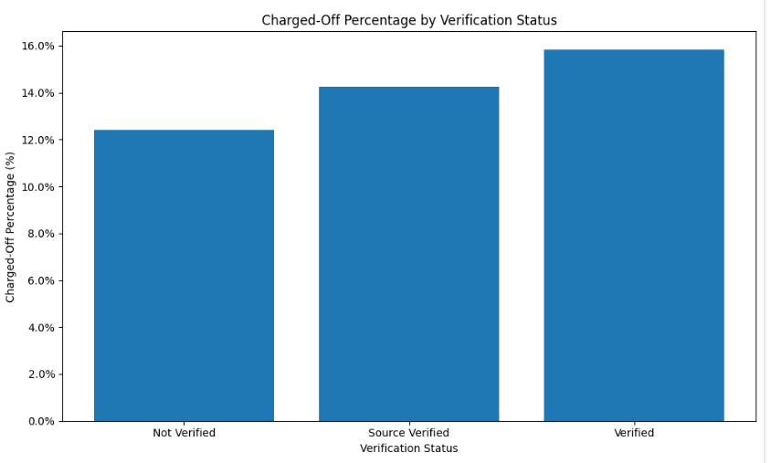
Loan Status Distribution by Verification Status
Most of the defaulters are coming under Verified Customers
States with a larger "Verified" segment tend to have more stringent income verification practices, while states with a larger "Not Verified" segment might have more relaxed requirements. This information can be useful in understanding regional lending patterns and potential risk factors associated with different states.

Slide 23
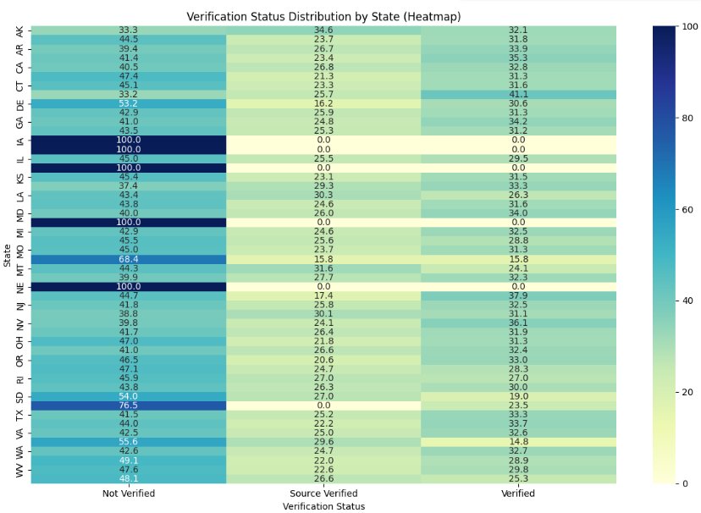
Verification status by State
States with a larger "Verified" segment tend to have more stringent income verification practices, while states with a larger "Not Verified" segment might have more relaxed requirements. This information can be useful in understanding regional lending patterns and potential risk factors associated with different states.
States like IA,KS,NE etc most of the loan is Not verified

Slide 24

Observations and Analysis

Slide 25
Loan Request coming under these categories are most likely to be a Defaulter
1 | From state NE,IA,KS
2 | Verified Customers
3 | Loan purpose for them are Small Business
4 | Customer Grade is Lower Grade (G) and they are charging more interest rate too
5 | Customer having higher experience coming under this category
6 | Highest percentage of defaulter is under **Other** home ownership and is followed by Rent and Own and Mortgage
7 | The percentage of Defaulters is much higher in 60 months term then 36 month
8 | Defaulters are mostly seen in the year 2011

Slide 26
Common Findings
1 | Loan applicants are increasing every year
2 | Debt Consolidation is the highest loan purpose, other uses are credit_card , other , home_improvement & major_purchase
3 | the maximum loan range amount is between 5000-10000
4 | The highest percentage of defaulter is under **Other** home ownership and is followed by Rent and Own and Mortgage
5 | 10+ years of employee exp. is having debt to income in maximum range apart from that rest year of employee exp. are more or less in same range.
6 | been observed that interest rates are increasing with the decrease in Grades, where A has lowest interest and G has highest
7 | Rising Delinquency Rates: If delinquency incidences are increasing in recent years, this could point to worsening borrower financial health, lending policy changes, or macroeconomic conditions influencing repayment behavior
8 | Improvement in Repayment: If the delinquency incidences are decreasing, it may reflect improvements in borrower financial stability, better loan management, or stricter lending standards
9 | Year-to-Year Volatility: If the error bars are large, it suggests that there are significant fluctuations in delinquency rates from year to year. This could be indicative of changing external factors, such as the economy or lending
10 | States with a larger "Verified" segment tend to have more stringent income verification practices, while states with a larger "Not Verified" segment might have more relaxed requirements. This information can be useful in understanding regional lending patterns and potential risk factors associated with different states.

Slide 27
Thank you

